Slide 1
THE INTEL INFRASTRUCTURE PROCESSING STRATEGY
IPU & IPDK
Software Networking

Slide 2
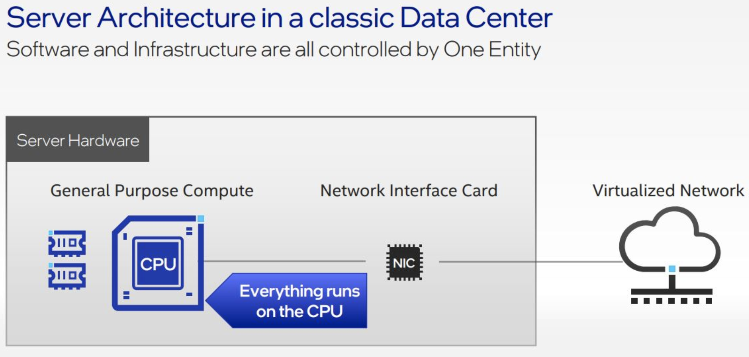
Introduction
CLASSIC DATA CENTER
[1] https://community.intel.com/t5/Blogs/Tech-Innovation/Data-Center/The-IPU-A-New-Strategic-Resource-for-Cloud-Service-Providers
Software Networking
Intel infrastructure Processing Strategy

Slide 3
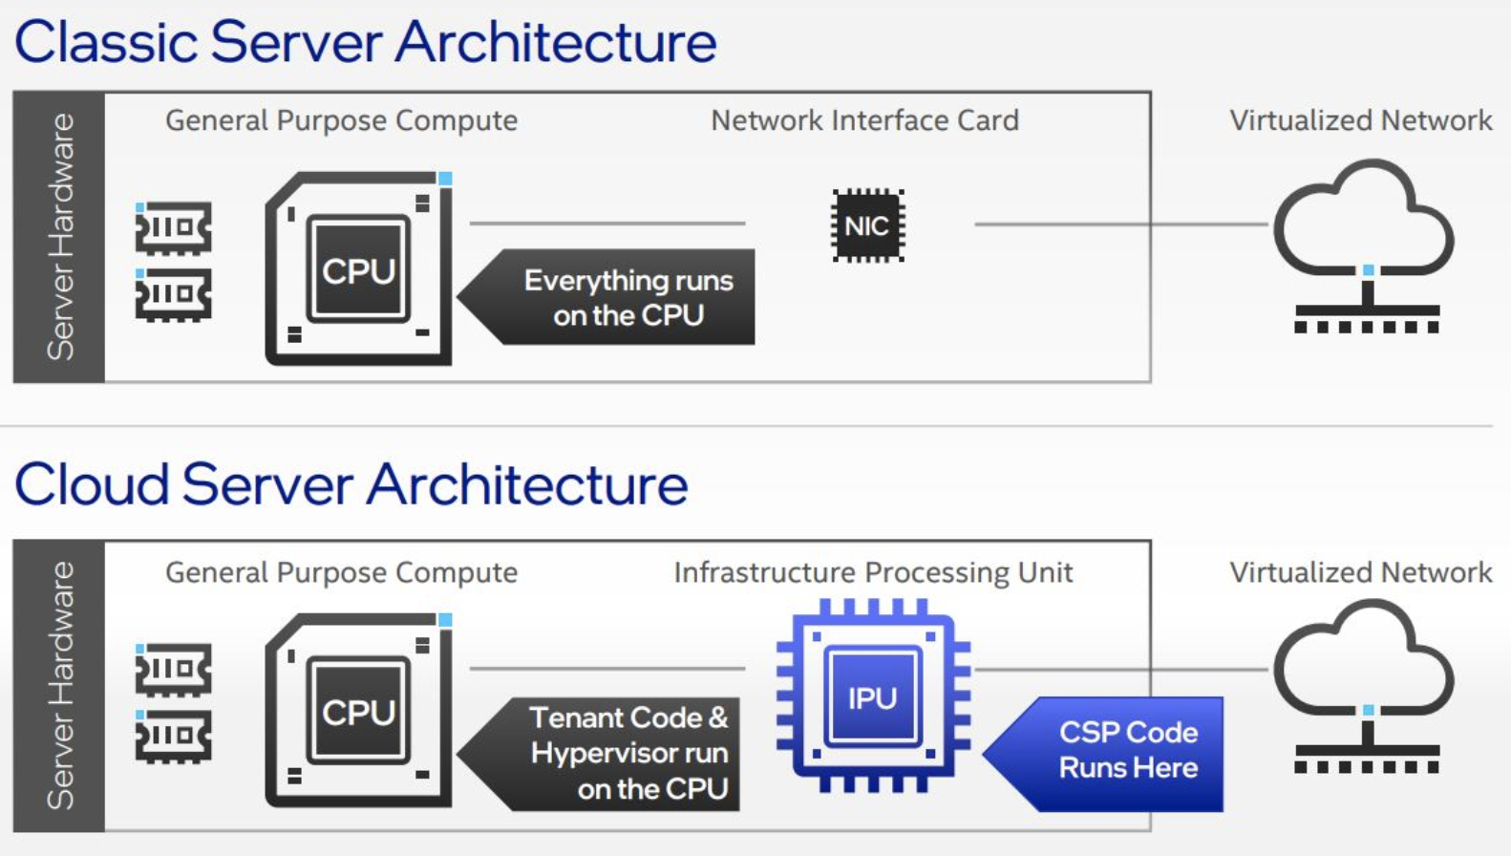
Intel© Infrastructure Processing Unit
[2] https://community.intel.com/t5/Blogs/Tech-Innovation/Data-Center/The-IPU-A-New-Strategic-Resource-for-Cloud-Service-Providers
Software Networking
Intel infrastructure Processing Strategy

Slide 4
IPU ≠ SmartNIC
«A SmartNIC is a programmable network adapter that can accelerate infrastructure applications, however, unlike an IPU it does not provide offload capability to run the entire infrastructure stack and therefore does not give the service provider an extra layer of security and control, enforced in hardware.»
[3] IPU Based Cloud Infrastructure White Paper
Software Networking
Intel infrastructure Processing Strategy

Slide 5
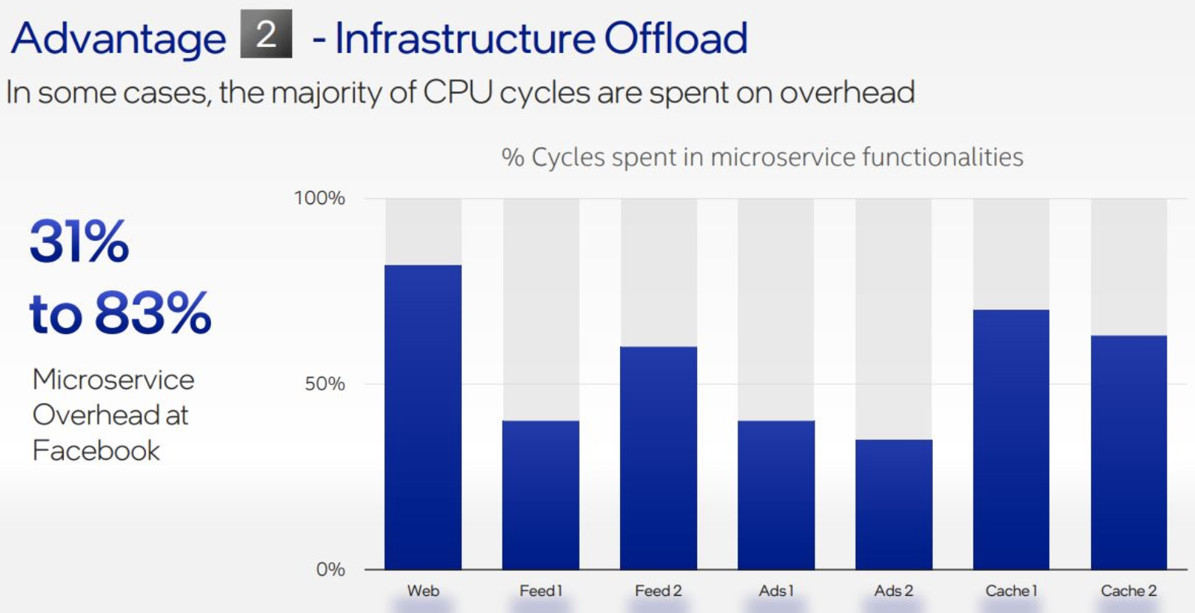
Microservices overhead
[4] https://community.intel.com/t5/Blogs/Tech-Innovation/Data-Center/The-IPU-A-New-Strategic-Resource-for-Cloud-Service-Providers
Software Networking
Intel infrastructure Processing Strategy

Slide 6
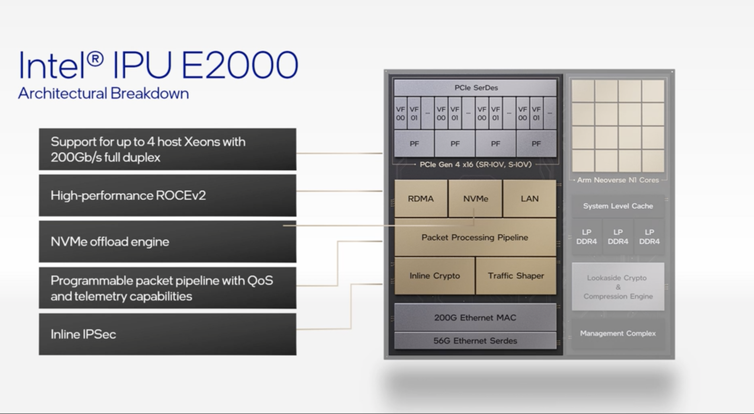
Work in progress..
[4] https://community.intel.com/t5/Blogs/Tech-Innovation/Data-Center/The-IPU-A-New-Strategic-Resource-for-Cloud-Service-Providers
Software Networking
Intel infrastructure Processing Strategy

Slide 7
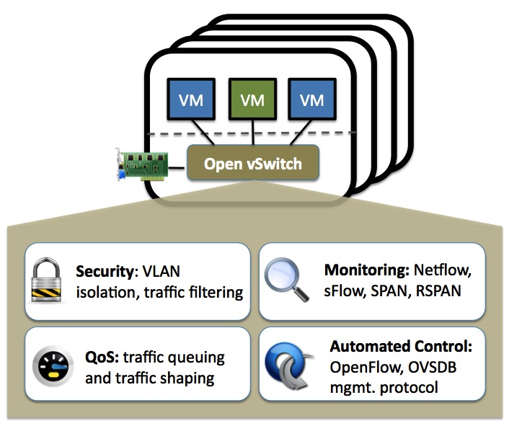
Open vSwitch
The device used in the Intel solution is the P4 OvS. Open vSwitch is a multilayer software switch licensed under the open source Apache 2 license.
Open vSwitch is well suited to function as a virtual switch in VM environ- ments. In addition to exposing standard control and visibility interfaces to the virtual networking layer, it was designed to support distribution across multiple physical servers. Open vSwitch supports multiple Linux-based virtualization technologies including KVM, and VirtualBox .
The bulk of the code is written in platform-independent C and is easily ported to other environments.
Software Networking
Intel infrastructure Processing Strategy

Slide 8
Main Components
The main components of this distribution are:
ovs-vswitchd, a daemon that implements the switch, along with a com- panion Linux kernel module for flow-based switching.
ovsdb-server, a lightweight database server that ovs-vswitchd queries to obtain its configuration.
ovs-dpctl, a tool for configuring the switch kernel module.
Scripts and specs for building RPMs for Red Hat Enterprise Linux and deb packages for Ubuntu/Debian.
ovs-vsctl, a utility for querying and updating the configuration of ovs- vswitchd.
ovs-appctl, a utility that sends commands to running Open vSwitch dae- mons.
Software Networking
Intel infrastructure Processing Strategy

Slide 9
P4 Programming
Software Networking
Intel infrastructure Processing Strategy

Slide 10
Motivation
Domain Specific Language
Protocol Agnostic Language
Single code base for multiple target
It brings several development improvements and increases maintainability, security and portability.
It removes some security issues that come with the non-specific domain languages, like C/C++
Software Networking
Intel infrastructure Processing Strategy

Slide 11
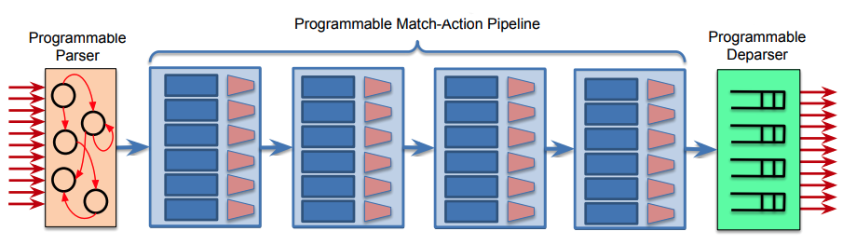
Architecture
Software Networking
Intel infrastructure Processing Strategy

Slide 12
P4 and eBPF
There are a bunch of projects working on the interoperability between P4 and eBPF
p4c-ebpf
p4c-xdp
p4c-ubpf
P4 is more restricted than eBPF but it guarantees a better portability and security
eBPF is more flexible than P4 so cross compile eBPF to P4 is more challenging
Software Networking
Intel infrastructure Processing Strategy

Slide 13
IPDK
Software Networking
Intel infrastructure Processing Strategy

Slide 14
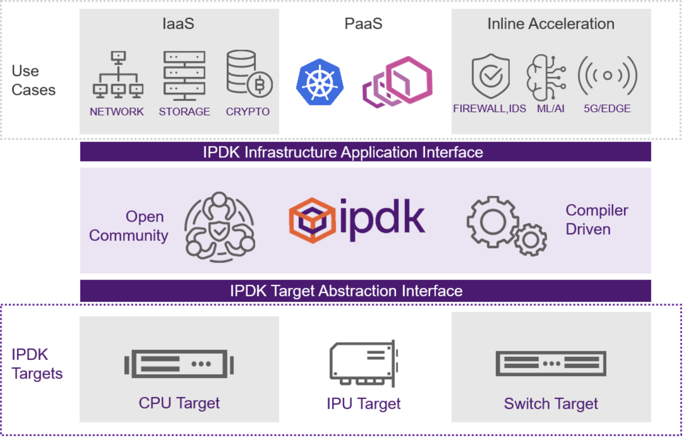
What is?
Target Agnostic Open-Source Development Kit which runs on CPU, IPU, DPU, DPDK
It creates an abstraction layer between the target and the implementation to offload
Software Networking
Intel infrastructure Processing Strategy

Slide 15
What is?
It provides us with a good number of recipe ready to use to build Virtual Networking and Virtual Storage
In the Development Kit we can find some CLIs which help us to perform common action like create interfaces, add/remove rules and manage the target
Currently only virtio-net is the virtual networking device while there are 3 different virtual storage devices:
virtio-blk
virtio-scsi
NVMe
Software Networking
Intel infrastructure Processing Strategy

Slide 16
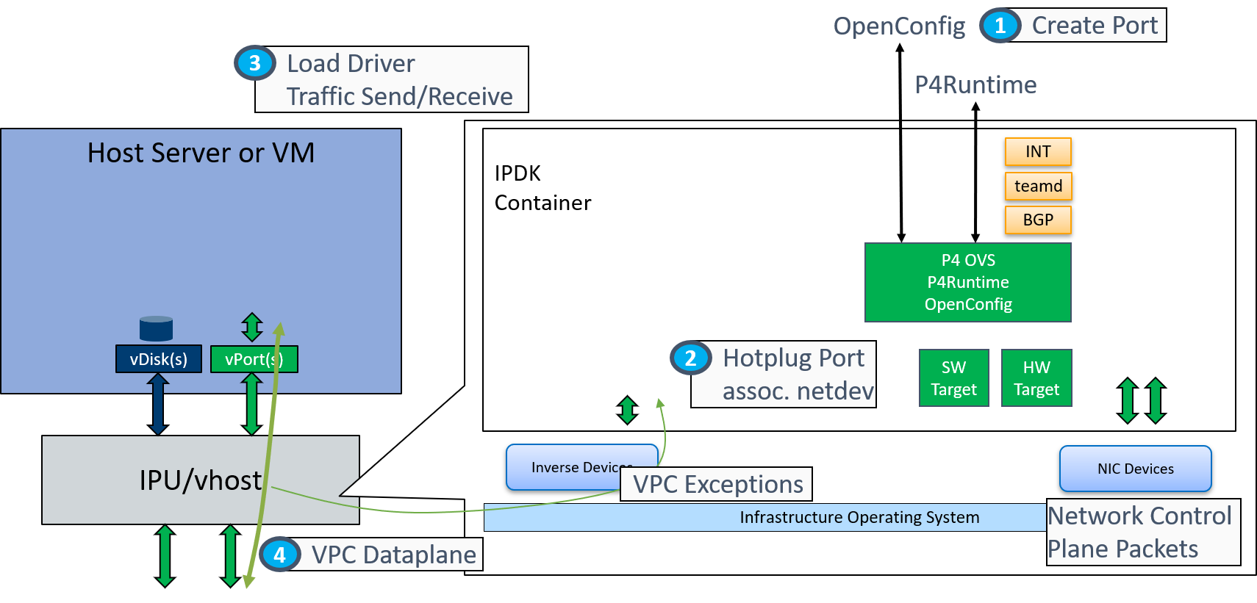
Virtual Networking
Software Networking
Intel infrastructure Processing Strategy

Slide 17
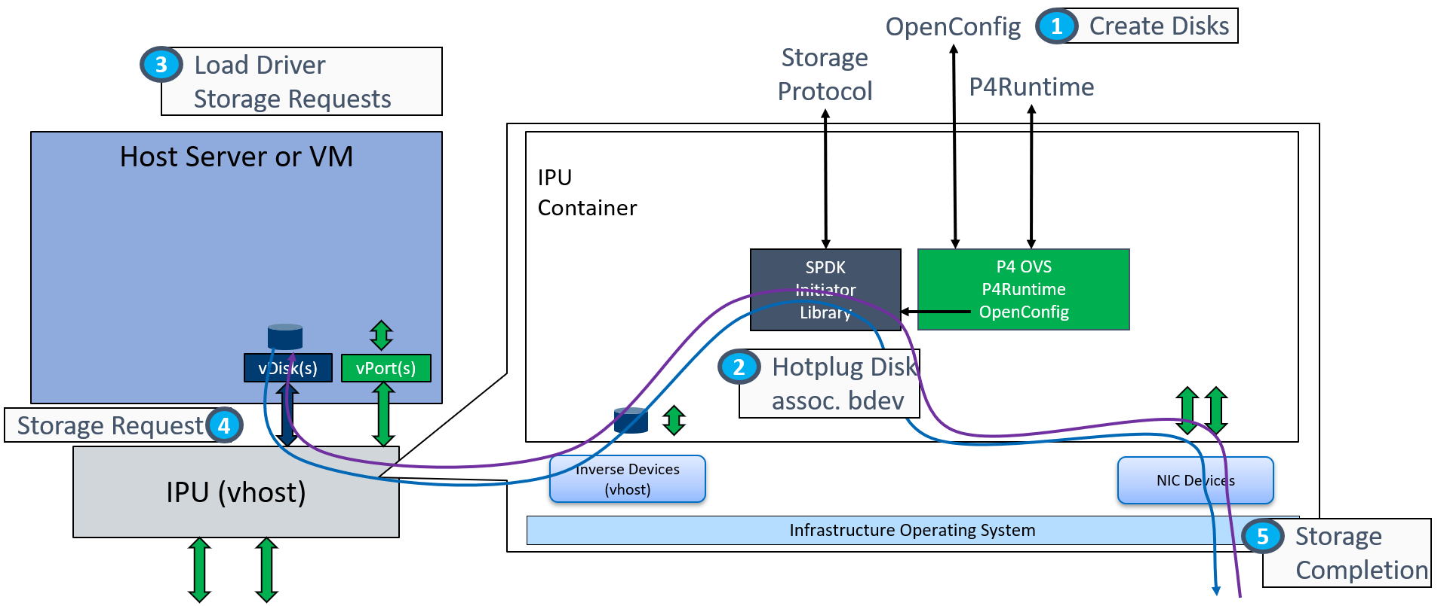
Virtual Storage
Software Networking
Intel infrastructure Processing Strategy

Slide 18
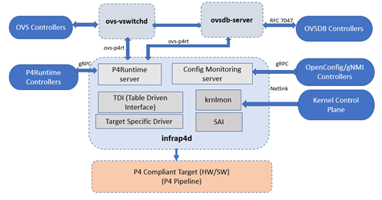
Internals
The main process is infrap4d (Stratum) which wraps some gRPC servers to manage the target
Software Networking
Intel infrastructure Processing Strategy

Slide 19
Internals
We always find 2 gRPC servers in the offloaded solution, in each target:
P4Runtime: queryable by ovs-p4rt CLI to manage the data plane
gNMI: gRPC Network Management Interface to manage the network configuration like vPorts
Each target may have additional servers, for example DPDK includes ovs-p4rt that is used to add/modify/delete P4 forwarding table’s entries.
There are other components:
TDI - Table Driven Interface: Set of APIs that enable configuration and management of P4 programmable devices. Each device can choose to use its own backends. Stratum uses this interface to talk to the target-specific driver
krnlmon - Kernel Monitor: receives RFC 3549 messages from the Linux Kernel over a Netlink socket when changes are made to the kernel networking data structures
SAI - Swtich Abstraction Interface: Switch Abstraction Interface (SAI) defines a vendor-independent interface for switching ASICs.
Software Networking
Intel infrastructure Processing Strategy

Slide 20
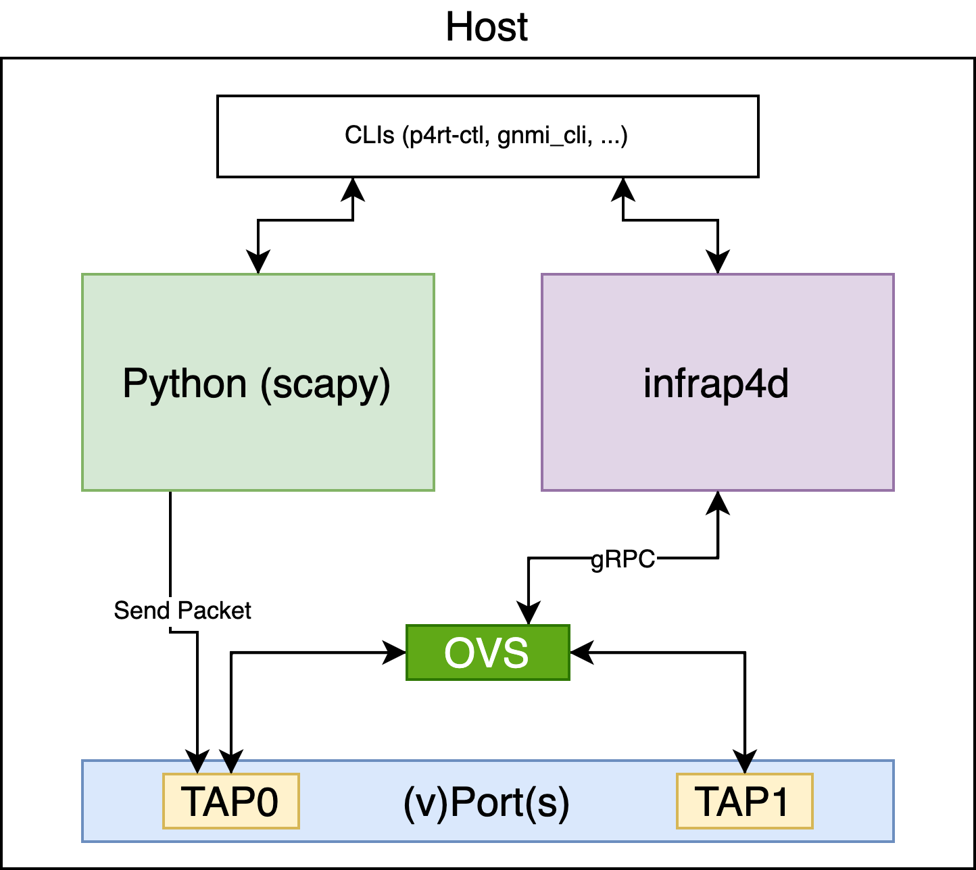
Example
The example will show:
A P4 program to perform IPv4 forwarding
Infrap4d running
How to create vPorts with gNMI CLI
How to create forwarding rules using p4rt-clt CLI
How to send packets in a test environment with scapy
Software Networking
Intel infrastructure Processing Strategy

Slide 21
Kubernetes
The Kubernetes recipe relies on Open vSwitch so in this moment is not possible to offload the k3s recipe to a hardware target but is in roadmap.
While using the k3s recipe the OVS will take care of the intra-node communication and packets will never reach the NIC until the pods are in different nodes.
The only supported DataPlane is Open vSwitch but in the future also Hardware targets and PINS (https://opennetworking.org/pins/) will be supported.
Software Networking
Intel infrastructure Processing Strategy

